Slide 1

Fast Food Pink Panther Crikvenica
Official Style Guide

Slide 2


INTRODUCTION
Welcome to my first Style Guide of my first real solo project where I created a website for Fast Food Pink Panther Crkvenica

Slide 3
TABLE OF CONTENTS
01
02
03
Strategy
04
Typography
Purpose, personality, target audience and voice
Fonts and font scale used throughout the project
Logo
05
Application feel
Logo concept, construction, dos and don'ts
Here
Color standards
Colors used throughout the project

Slide 4
01
STRATEGY
Purpose, personality, target audience and voice

Slide 5
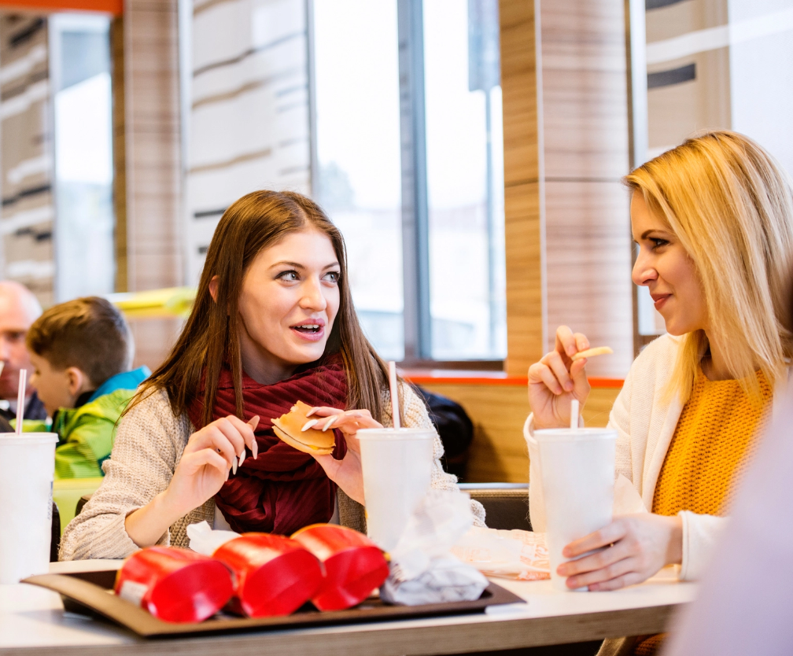
PURPOSE
Their purpose is to satisfy every guest who visits them
So that the guests, when they leave, spread the story about them and come back again

Slide 6
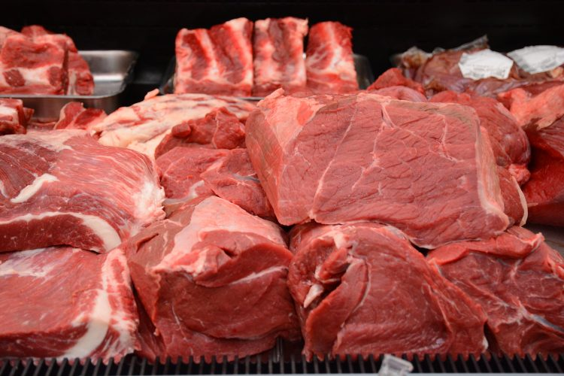
PERSONALITY
Their personality is based on the knowledge they like to enrich and the service they like to perform
They care about people and their health. That's why on their menu you can find only fresh foods and top quality local meat

Slide 7
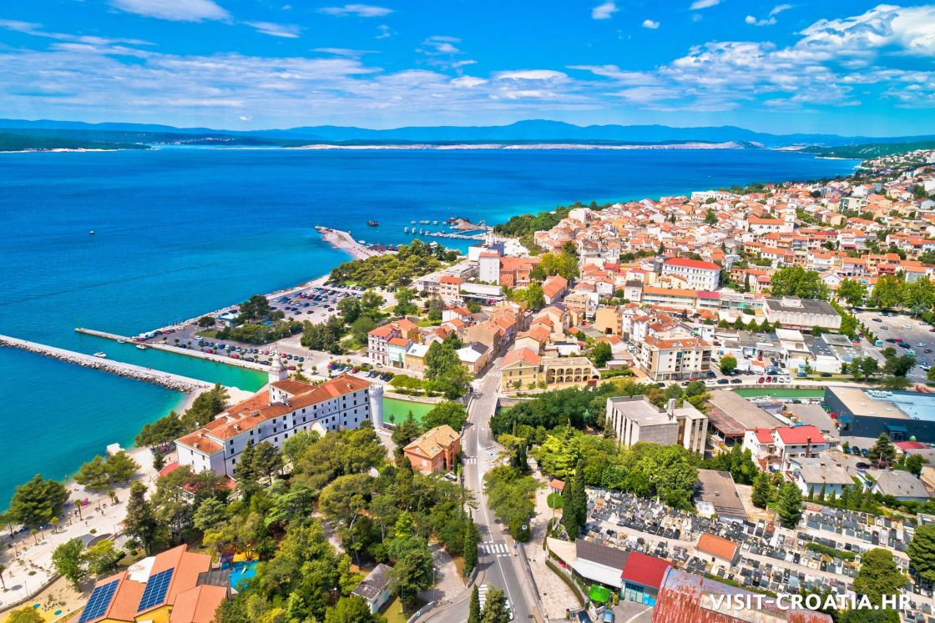
TARGET AUDIENCE
The target audience is tourists during the summer season, so for them there is a translation in 3 languages on the website
The residents of Crikvenica must also be mentioned, because of which fast food works all year round

Slide 8
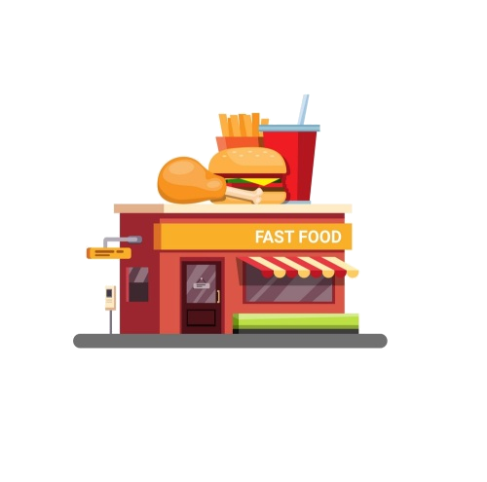

VOICE
Since all their employees are always polite, friendly and kind to all guests. Always helpful for all your requests and questions.
These qualities would be their voice, that is, what people see them as.

Slide 9
02
LOGO
Logo concept, construction, dos and don'ts

Slide 10

LOGO CONCEPT
The logo is completely taken from the Pink Panther cartoon with the inscription
Fast Food Pink Panther Crikvenica
in the recognizable Pink Panther font
Fast Food Pink Panther Crikvenica

Slide 11
BRAND CONSTRUCTION
40px
40px
The dimensions used as the logo are 40x40 px because they are in the navigation bar
If logo is used somewhere else on page it should not be bigger than some card

Slide 12
DOS
P
Make the logo the ideal size in relation to its surroundings
Put logo in a suitable background color

Slide 13
DON’TS
Don’t resize the logo
Don’t put logo in the same background color as he is
Don’t make logo too big
Don’t change color of logo

Slide 14
03
COLOR STANDARDS
Colors used throughout the project

Slide 15
COLOR STANDARDS
#F8F9FA
#FFC0CB
#F977AA
#F08080 #FF69B4
RGB: 248 249 250
RGB: 255 192 203
RGB: 249 119 170
RGB: 240 128 128
RGB: 255 105 180

Slide 16
COLOR GUIDELINES
CULTURED
PINK
CYCLAMEN
LIGHT CORAL & HOT PINK
Used for navbar and footer background
Used for cards body background
Used for buttons backround
Userd for prices background

Slide 17
04
TYPOGRAPHY
Fonts and font scale used throughout the project

Slide 18
TYPOGRAPHY
Aa
Aa
EBGaramond-Regular
Aa Bb Cc Dd Ee Ff Gg Hh Ii Jj Kk Ll Mm Nn Oo Pp Qq Rr Ss Tt Uu Vv Ww Yy Zz
Aa
EBGaramond-Italic
Aa Bb Cc Dd Ee Ff Gg Hh Ii Jj Kk Ll Mm Nn Oo Pp Qq Rr Ss Tt Uu Vv Ww Yy Zz
Desigers
Aa Bb Cc Dd Ee Ff Gg Hh Ii Jj Kk Ll Mm Nn Oo Pp Qq Rr Ss Tt Uu Vv Ww Yy Zz

Slide 19
Aa
Aa
Aa
Desigers
Used for page headings and prices
Official Pink Panther font
EBGaramond Regular
EBGaramond Italic
Used for everything
Used for food
description in menu

Slide 20
FONT SCALE
Font scale used in this project is Major Third:
61.04px
48.83px
39.06px
31.25px
25.00px
20.00px
16.00px
Used for heading on home page
Used for headings of pages
Used for heading of main sections
Used for quotes and some subheadings of sections
Used mostly for buttons and card headings
Used for navbar links and prices
Used for descriptions, most often in cards

Slide 21
05
APPLICATION FEEL
You can enter a subtitle here if you need it

Slide 22
Light mode je zbog toga sto je najposjecenije u doba sezone kad su skoro uvijek jako suncani dani pa da se oci ne umaraju dok gledaju u mobitel
Aplikacija je radena tako da je na prvom mjestu da mora biti prilagodena svim mobilnim uredajima bas zbog hrane, mora i sezone..

Slide 23

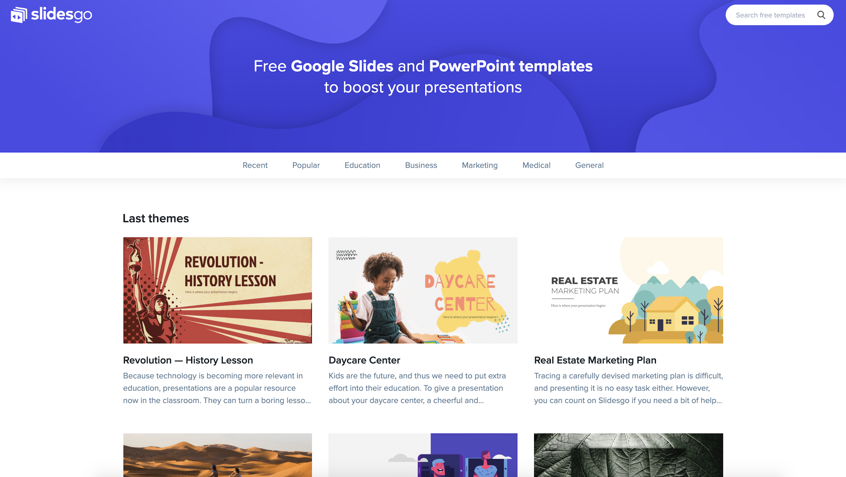
Mockup
You can replace the image on the screen with your own work. Just delete this one, add yours and center it properly

Slide 24
ICONOGRAPHY

Slide 25
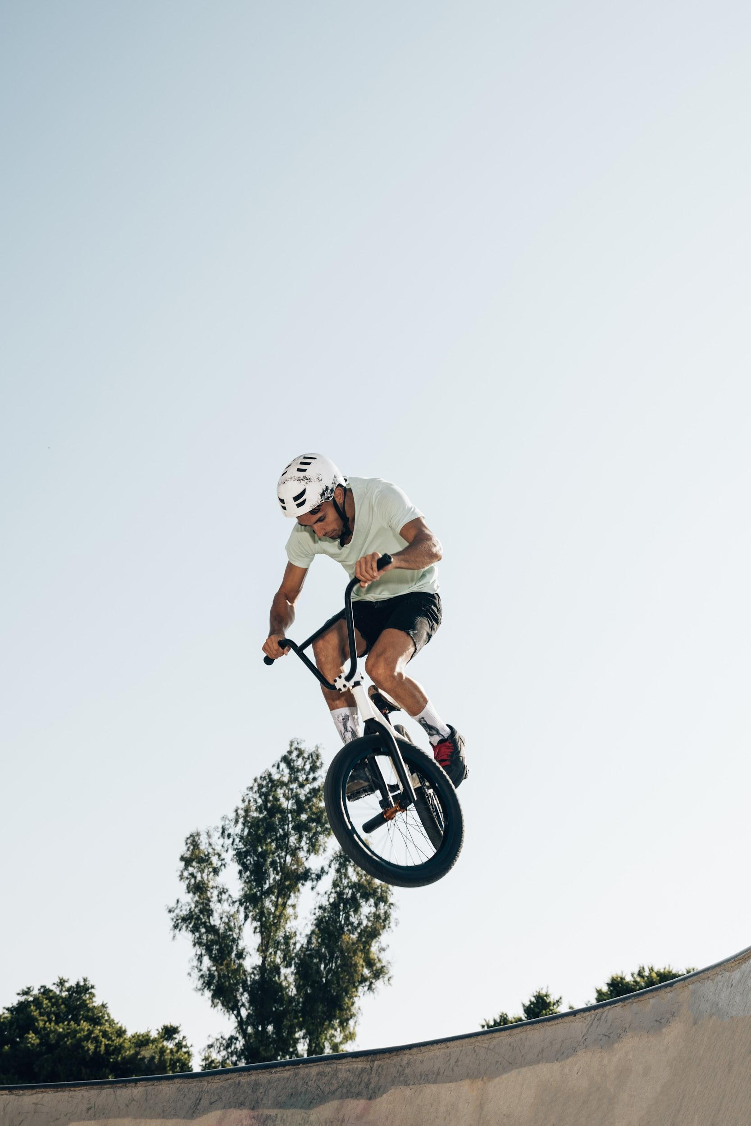
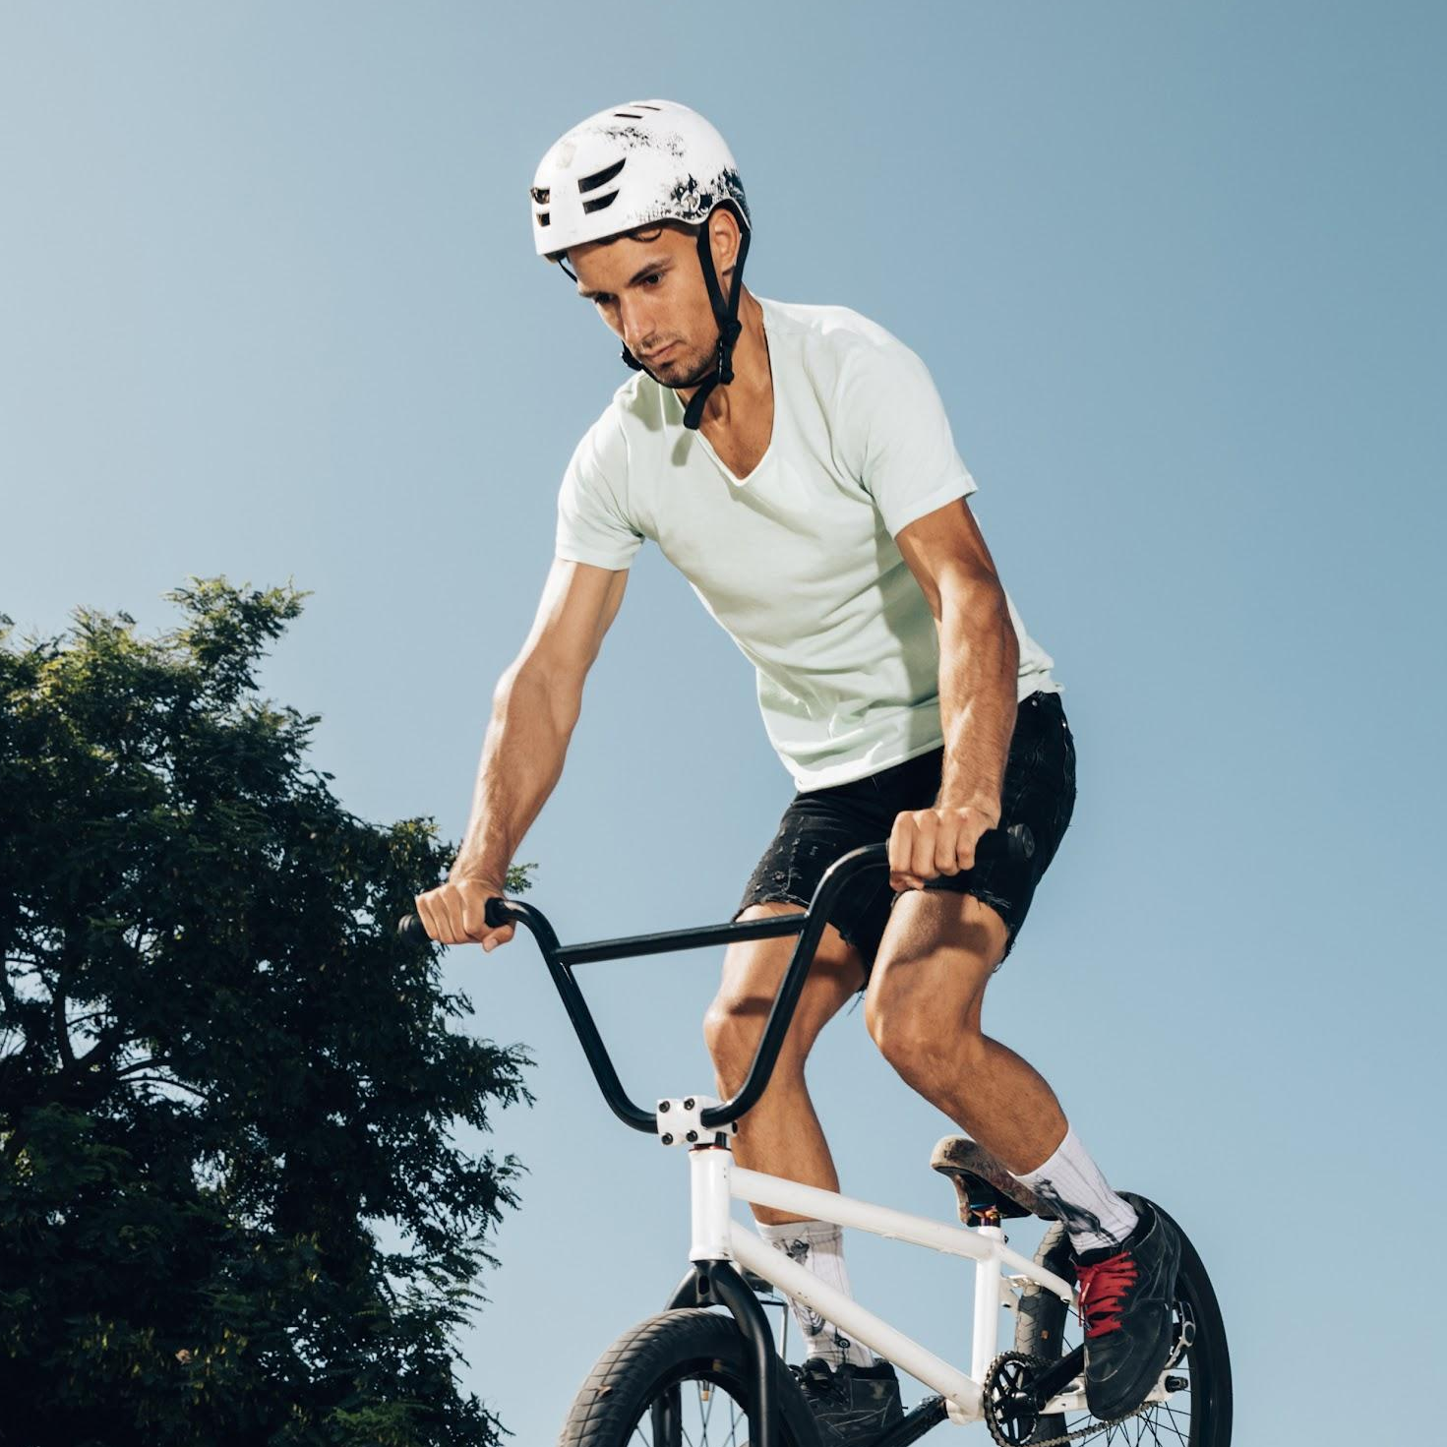
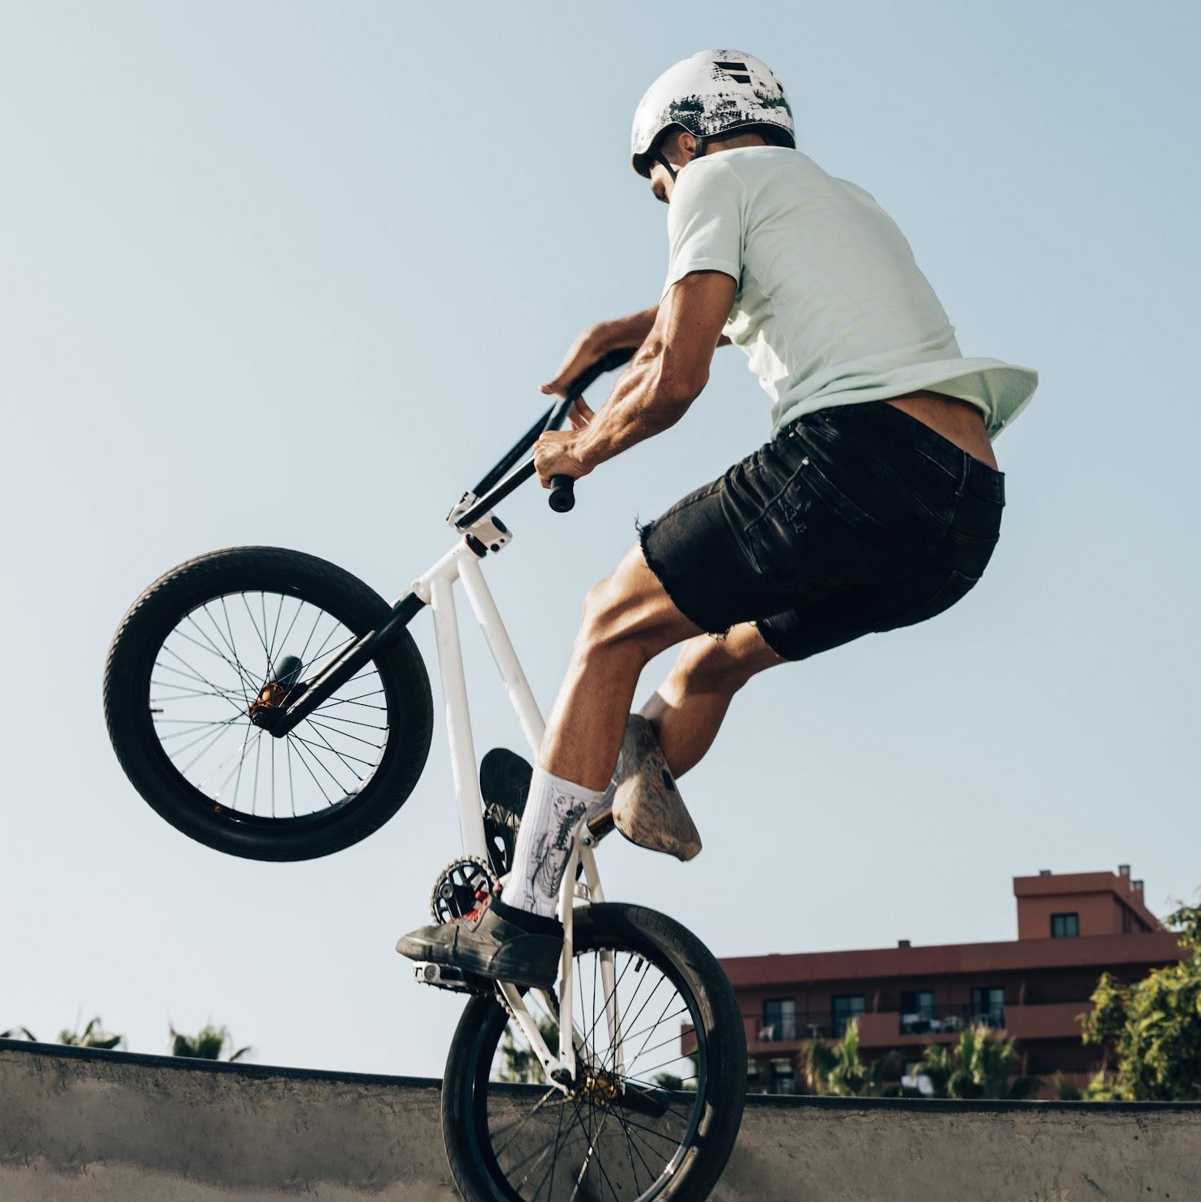

IMAGE GUIDELINES
Venus has a beautiful name and is the second planet from the Sun. It’s terribly hot, even hotter than Mercury

Slide 26
IMAGE CONCEPT
Mercury is the closest planet to the Sun and the smallest one in the Solar System—it’s only a bit larger than the Moon

Slide 27

HEADQUARTERS
Jupiter
Jupiter is the biggest planet in the Solar System
Mars
Despite being red, Mars is actually a cold place

Slide 28
OUR HISTORY
1
2
3
4
Venus is the second planet from the Sun
Saturn is a gas giant and has several rings
Despite being red, Mars is a cold place
Mercury is the closest planet to the Sun

Slide 29

“This is a quote, words full of wisdom that someone important said and can make the reader get inspired.”
—Someone Famous

Slide 30
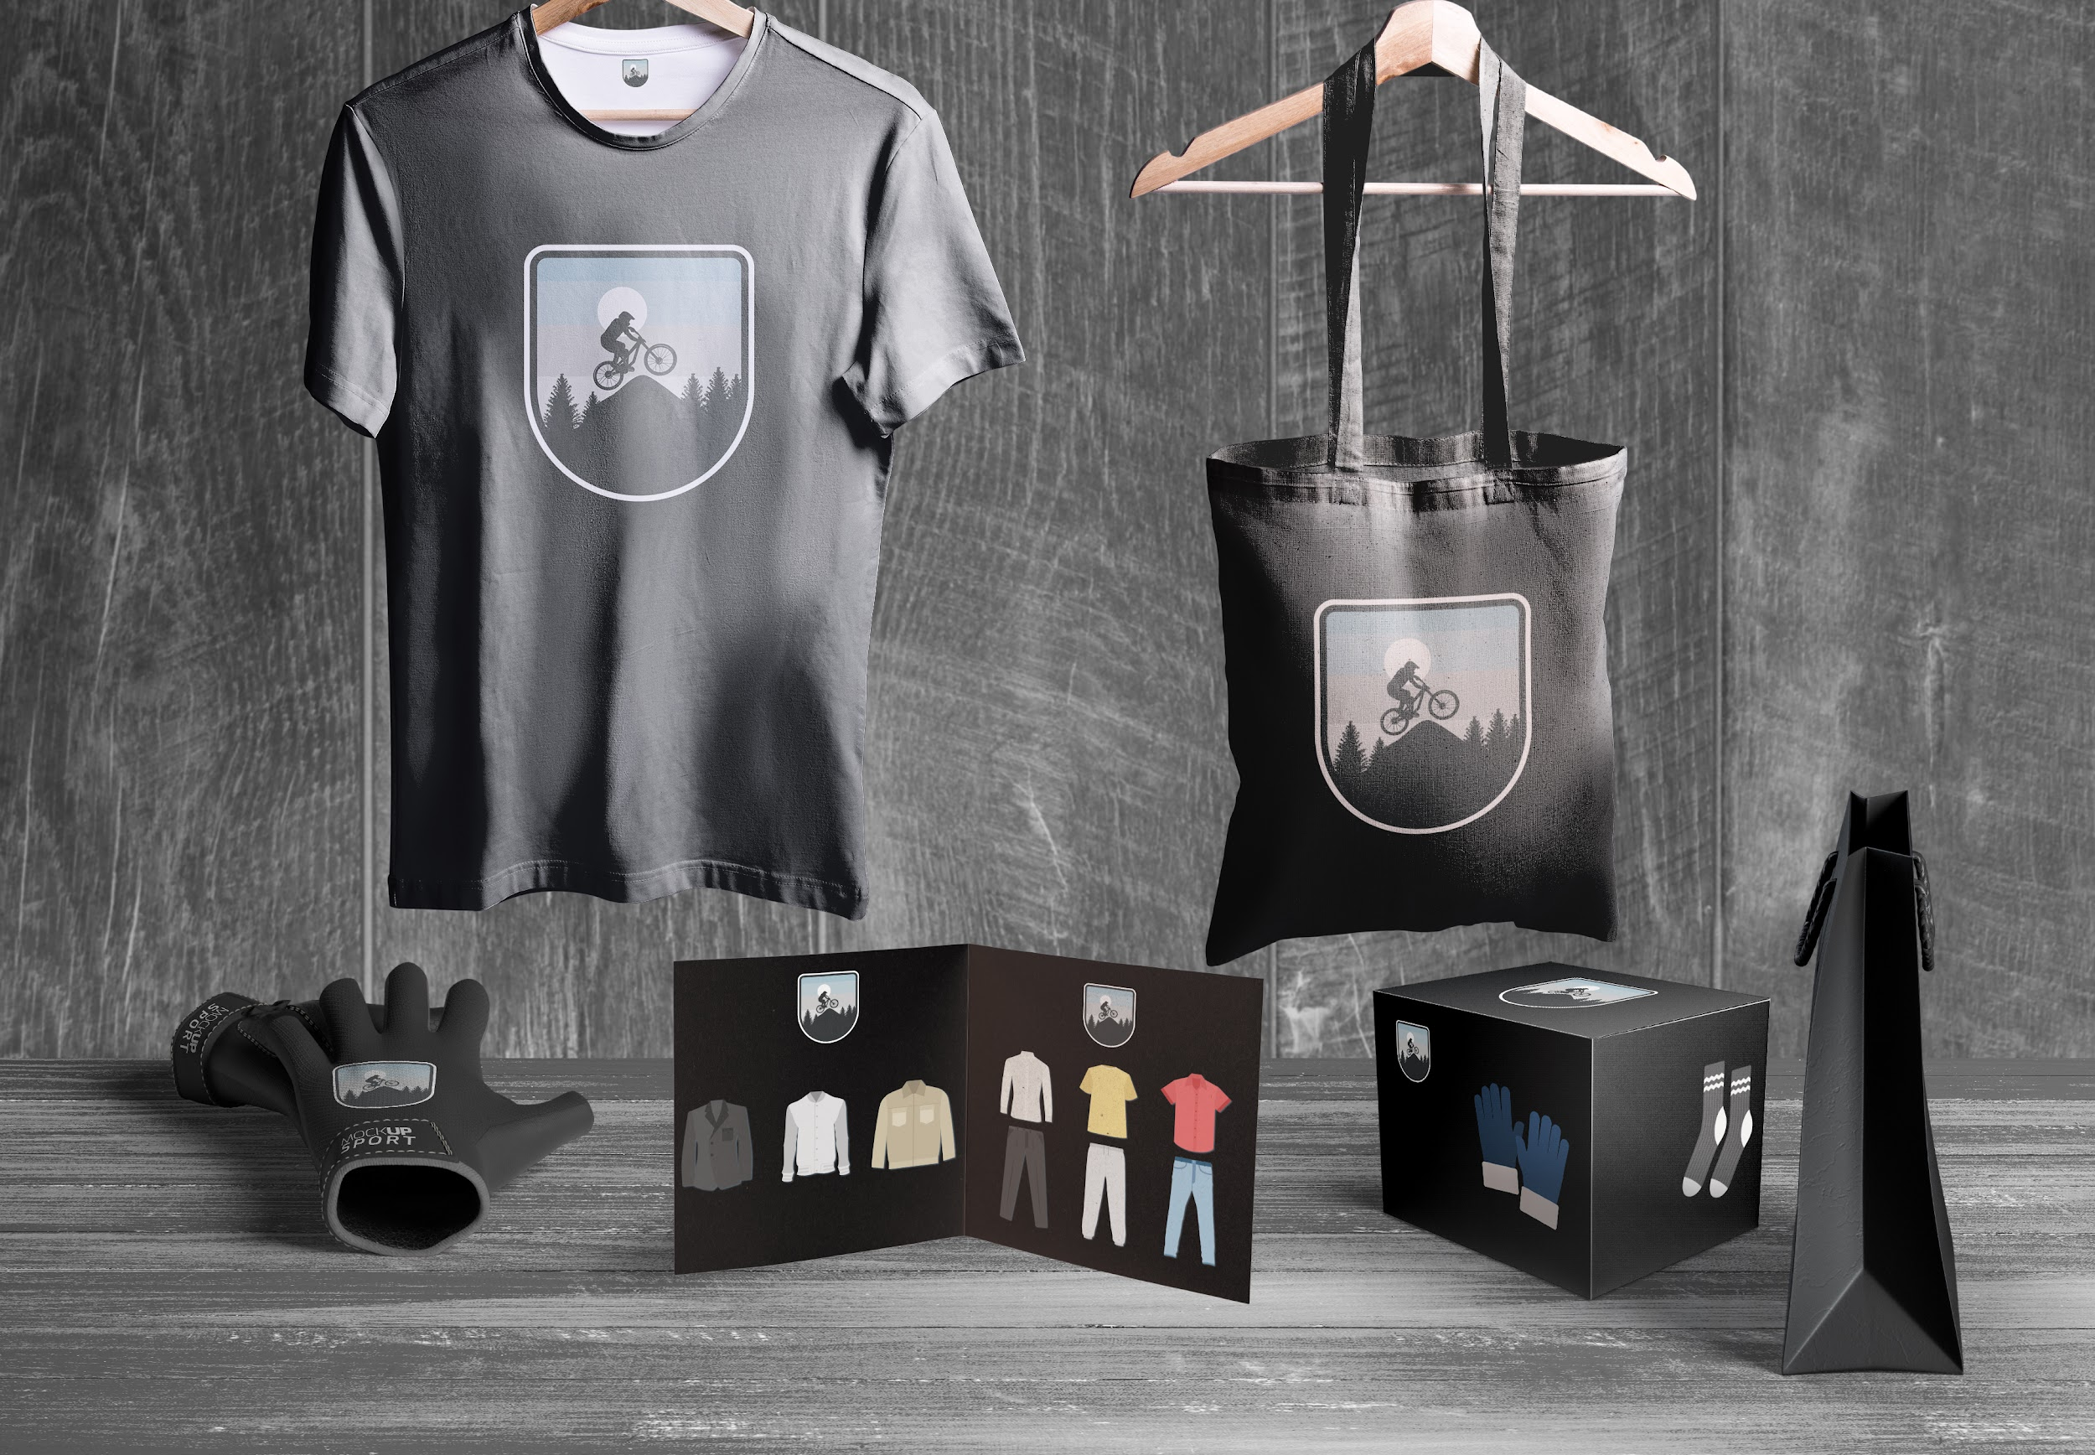
APPLICATIONS
Venus is a planet with a beautiful name and is the second one from the Sun. It’s terribly hot and its atmosphere is poisonous

Slide 31
THANKS!
Do you have any questions? youremail@freepik.com +91 620 421 838 yourcompany.com
Please keep this slide for attribution.

